Slide 1


To unbundle big deals or not ? the Universite de Montreal’s experience
Stéphanie Gagnon
Directrice des collections
Bibliothèques de l’Université de Montréal CLAW, October 15th 2015

Slide 2
Université de Montréal
Who are we?
Our context

Slide 3
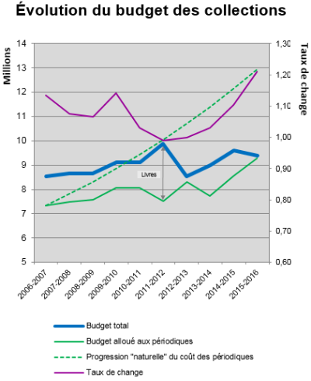
Breaking point

Slide 5
Why unbundle big deals ?

Slide 6

Unbundling a big deal
négociationid
identificationva
Communications
Tools for identifying the most valued titles
Negotiations

Slide 7

Communicate the project to the community

Slide 8
1st experience : Unbundling Wiley
How did we proceed?
Results
Impact on the community and recommendations of our library advisory committee :
Create a working group on the periodicals collection to improve the methodology

Slide 9
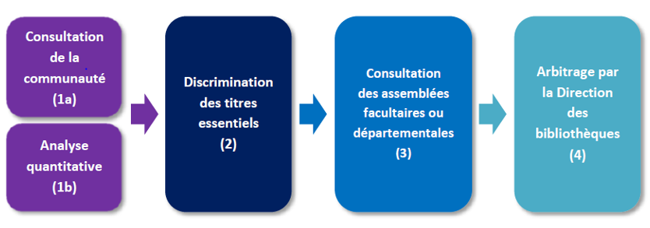
5 easy steps to identify our most valued titles before considering unbundling

Slide 10
Survey : identify the essentials
10 essential titles for your research and teaching activities
5 essential titles for your subject area
What is the impact of getting your article through ILL (24-48h delay) instead of immediately ?
No impact
Minor impact
Major impact
Unacceptable
Quantitative metrics
Usage statistics
Citations

Slide 11
downloads
citations
mentions
Health
Sciences & Engineering
SSHSL
downloads
citations
mentions
downloads
citations
mentions
Essential Titles
80%

Slide 12
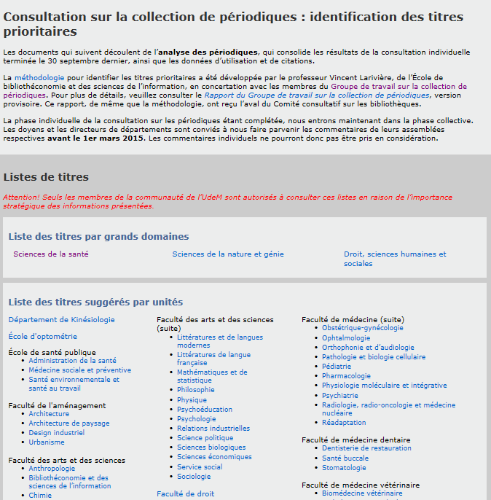

Slide 14
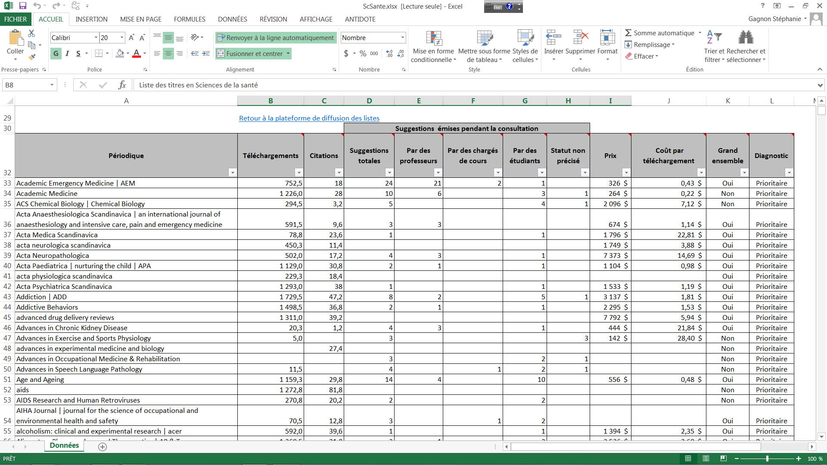

Slide 15
Essential titles by publisher
SHSSL
SNE
Health

Slide 16
Arbitration by library team
Batch A
Must-haves:
Essential titles (downloads, citations, mention by community in survey )
Batch B
For libraries arbitration:
Units’ suggestions
Libraries’ suggestions
French and Canadian titles
Essentials, but not «must»

Slide 17
Global results
UdeM’s collection | 50 000 periodicals
Downloaded periodicals | 16 816
Referenced periodicals | 9 075
Mentioned by our community in the survey | 8060
 | Subtotal : 26 843
«essential titles» (80%) | 4 852
Additional titles (from validation by units) | 1 041
 | Subtotal : 5 893
2 940 titles with quantitative approach | 2 953 titles from community consultation

Slide 18
Ready to negotiate - approaches
Title by title approach
Same content with compromises
Price list
Volume discount
New fees (more than list price)
From big deal to subject collections
Non-evolving collection
One-time purchase or any other investment needed to be combined with a reduced investment (ex : Evidenced base acquisitions)
Loss of perpetual access

Slide 19
results
Savings | Contents | Other benefits
Big deals | Improvements in Wiley’s collection (since the 1st unbundling) Most valued titles known | Credibility Community informed, engaged and supportive Focus on OA
Indexes and databases Factiva, Books24/7, PressDisplay, GBIP, ProQuest Psychology Journals, Current Content, SPIE | Better knowledge of our community’s needs Powerful analytical tool

Slide 20
What have we learned ?
In a risky situation, the secret is communication
Community participation is crucial
credibility,
fairness,
mobilisation
Transparency
Flexibility, resilience
No place for dogmatism, no «jusqu’au boutisme» (diehard)
Creativity
Stay calm !!

Slide 21

conclusion

Slide 22

Questions ?
Stéphanie Gagnon
Stephanie.Gagnon.16@umontreal.ca
514 343-7653
http://www.bib.umontreal.ca/collections-nouvelle-ere/

